Slide 1
Artificial Neural Networks
“Universal Approximators”
Dr Yves Matanga

Slide 2
Outline
  Artificial Neural Networks
      Theory and Practice

Slide 3
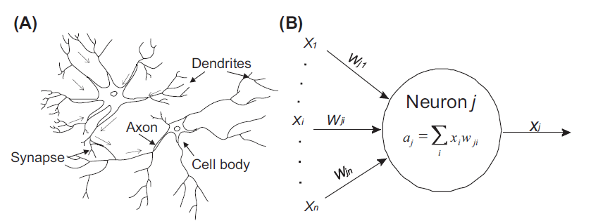
Artificial Neural Networks
ANNs are neural computation systems proposed originally by McCullock and Pitts (1943) and Metropolis et al (1953). They are inspired from the learning mechanism of the brain and shares high level similarities with biological neural networks.

Slide 4
A Biological Neuron
A biological neuron will have four important parts:
The nucleus or cell body,
The axon,
Synapses
Dendrites.
Neurons process information using electrochemical signals. Dendrites are entry points of information (electric signals) from other neurons. The axon is a long projection of the cell body through which information comes out of the neuron. Synapses are in between junctions across which information passes from neuron to another (axon-dendrite, axon-axon, axon-soma(nucleus)).

Slide 5

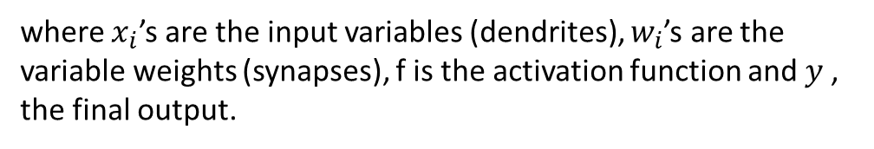
Artificial Neurons vs Biological Neurons
$$y = f\left(\sum_{i=1}^{P}{{w_{i}x}_{i}}\right)$$
where $x_{i}$’s are the input variables (dendrites), $w_{i}$’s are the variable weights (synapses), f is the activation function and $y$, the final output.

Slide 6
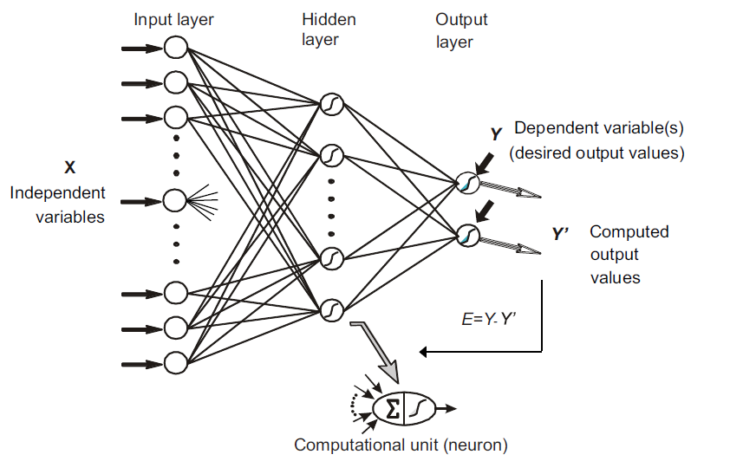
Multilayer Perceptions (MLP)
Also called multilayer feed-forward neural networks are very popular ANNs that are used for a wide variety of problems. They can be used for both regression and classification
Feedforward networks comprises of three main layers: the input layers that comprises input variables only. The hidden layer(s) that contain(s) the set of neuronal of which is fed all the output of the previous layer equitable, each having a terminal activation function and the output layer(s) which comprise(s) of terminal neurons that produce the output.

Slide 7
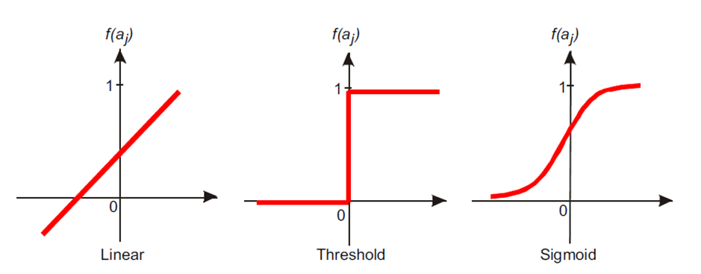
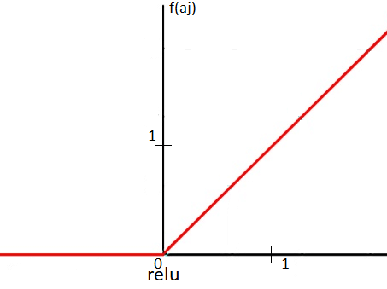
Activations Functions in MLP Models

Slide 8
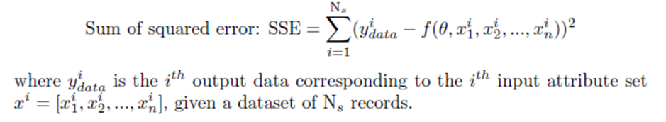

Training a MLP model
  MLP models have got a larger number of parameters, and uses an adapted gradient descent training methodology called the « backpropagation method »

Slide 9
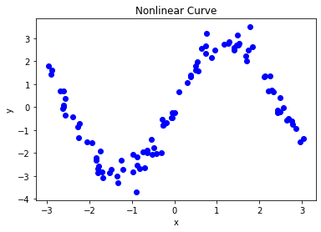
Using a MLP for nonlinear regression
  Given the a 2D dataset describing a nonlinear relationship in the data, make use of a MLP regression model to learn the inherent pattern.

Slide 10
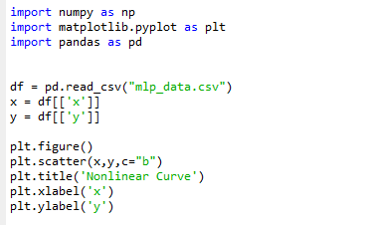
Loading the datasets

Slide 11
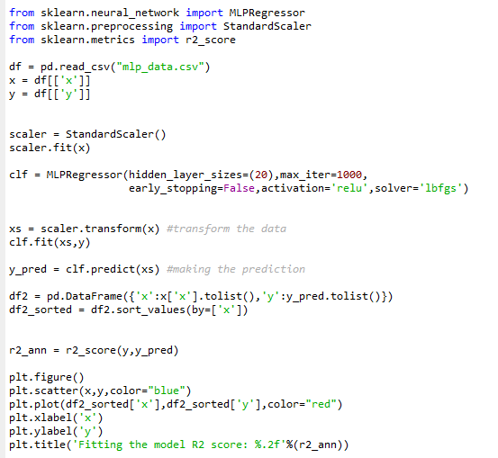
Building the model
(20,30,20)
(20,30,20)
activation_fnc

Slide 12
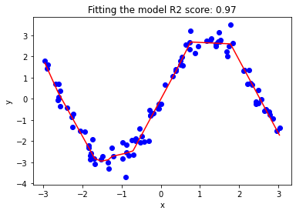
Fitting the model

Slide 13
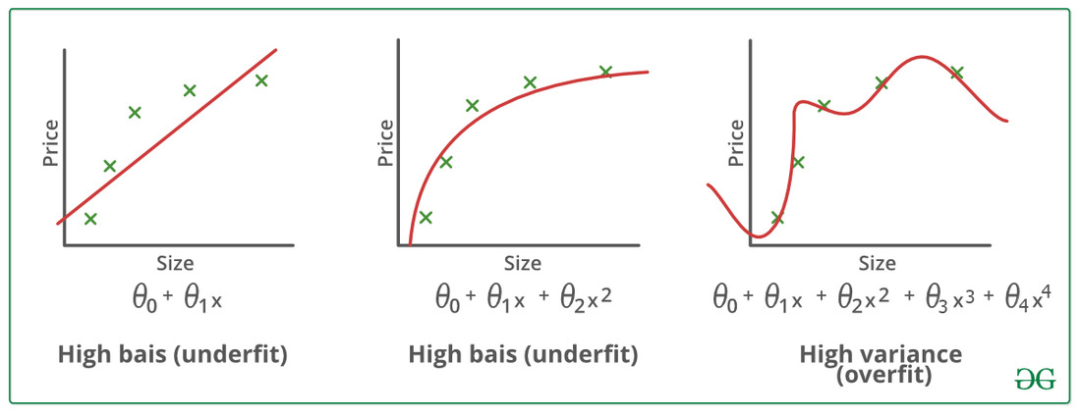
The risk of overfitting

Slide 14
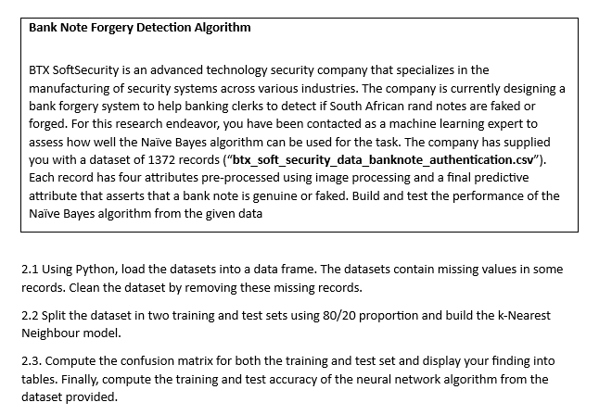
Exercises
  Using a MLPClassifier,
  apply neural network
  to a classification problem.

Slide 15
THANK YOU

